Slide 1
Binary Search

Slide 2

Question?
What is the fastest way to search about a word in an English dictionary?

Slide 3
Binary Search
Binary Search is an efficient search algorithm that find the position of a target in a sorted range
For each step in binary search:
the middle element of the remaining range is checked
The half ,in which the target can not exist, is excluded from the range
The complexity of binary search is O(log(n)) which is more better than the linear complete search O(n)

Slide 4
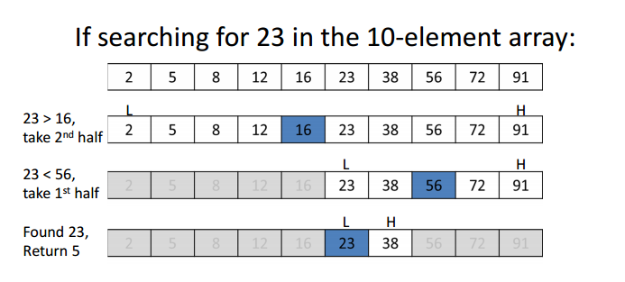
Example
You are given the following sorted array, and you are required to find the position of 23

Slide 5
Example
The current middle is 16,
Which is smaller than 23,
And as the range is sorted,
So it’s impossible to find 23 in the first half before 16,
So the first half is excluded,
And the current search range is only the second half

Slide 6
Example
The current middle is 56,
Which is greater than 23,
And as the range is sorted,
So it’s impossible to find 23 in the half after 56,
So the second half is excluded,
And the current search range is only the first half

Slide 7
Example
The current middle is 23,
Which equals to our target,

Slide 8
Code
int binarySearch(int tar, vector<int>& arr){
int lo=0, md, hi=arr.size()-1;
while(hi>=lo){
md=(lo+hi)/2;
if(arr[md]==tar) return md;
else if(arr[md]<tar) lo=md+1;
else hi=md-1;
}
return -1;
}

Slide 9
Binary Search (Generalization)
The scope of using binary search is way bigger than using it to search for an element in an array.
Binary search can also be used to search about an element that has the maximum/minimum behaviour.
In other words, searching about an element that solve a problem maximally or minimally

Slide 10

Example
Imagine a building with 14 floors, and there is a man holding some eggs. This man wants to know what is the highest floor where the egg will not broken if it’s thrown

Slide 11
Example
The man should try throwing an egg from the 7-th floor (the middle)
If the egg is broken, so surely it will be broken if it’s thrown from any floor higher than the 7-th, so he should try the floor from 1 to 6
If the egg is not broken, so surely it will not be broken if it’s thrown from any floor less than the 7-th, so he should try the floor from 7 to 14 searching for the maximum floor

Slide 12
Code
bool ok(int floor){
cout<<floor<<'\n';
int isBroken;
cin>>isBroken;
if(isBroken==1)
return false;
return true;
}
int binarySearch(int n){
int lo=1, md, hi=n;
while(hi>lo){
md=(lo+hi+1)/2;
if(ok(md)) lo=md;
else hi=md-1;
}
return hi;
}
Adding 1 is considered as ceiling. this is required with maximization problems to avoid infinite loop at last iteration.

Slide 13
binary-searchable range?
A range is called binary-searchable if it’s valid to perform binary search over it
But how to know if it’s binary-searchable or not?
The range should be divided into two parts, one part is responding false to the OK FUNCTION, and the other part is responding true
OK function reponses : T T T T T F F F F F (binary-searchable)
OK function reponses : T T F F T T F T F F (not binary-searchable)

Slide 14
To Solve
Search Insert Position
Koko Eating Bananas
Magic Powder - 2

Slide 15
Two Pointers

Slide 16
Two Pointers
Two Pointers is an efficient technique that is used for searching over range of elements
This technique uses left and right pointers and moves them according to the suitable greedy decisions
This technique can solve problems in O(n) insead of O(n^2), and sometimes it can solve binary search problems

Slide 17
Example
You are given a sorted array of N integers, you are asked to check if there exists any pair of integers that their sum equals to S
5 6
1 2 3 4 6
True
6 10
1 3 4 5 8 11
False

Slide 18
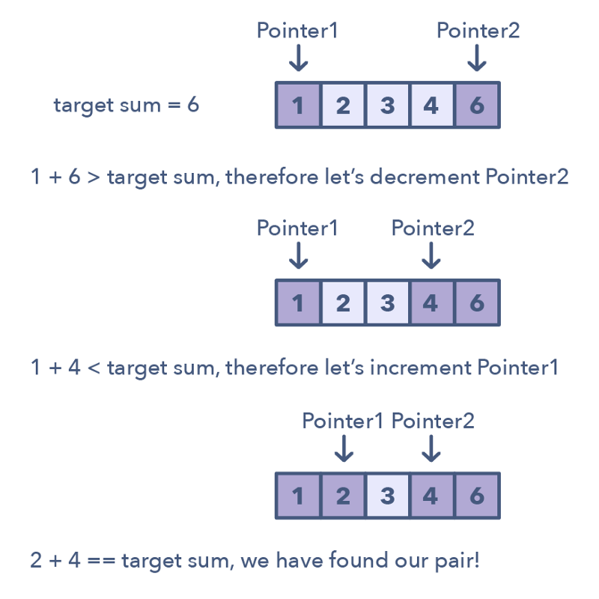
Solution
Initially , a left pointer is pointing to the first element, and a right pointer is pointing to tha last element
The current sum is (1+6) 7 which is greater than our target (6)
So we should move the right pointer to get smaller sum
The current sum is (1+4) 5 which is smaller than our target (6)
So we should move the left pointer to get bigger sum
The current sum is (2+4) 6 which is our target

Slide 19
Code
bool solve(vector<int>& arr, int tar){
int l=0, r=arr.size()-1;
while(l < r){
int curSum=arr[l]+arr[r];
if(curSum==tar) return true;
else if(curSum > tar) r--;
else l++;
}
return false;
}

Slide 20
To Solve
Counting Kangaroos is Fun
Longest Substring Without Repeating Characters

